Slide 1


Web Deployment
with Windows Azure
Joachim Leonfellner

Slide 2
Goal
Web deployment
WebMatrix
Bootstrap
Add Git Version Control
Deployment via Git

Slide 3
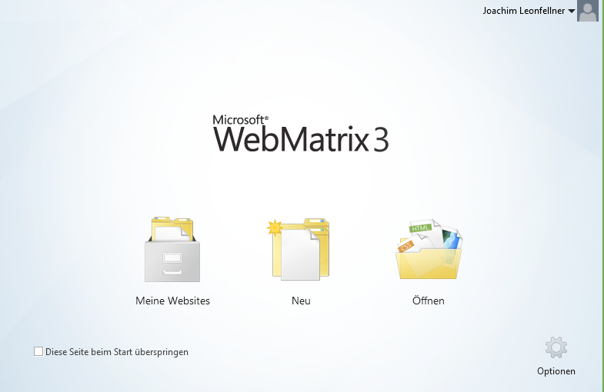
Get WebMatrix
http://www.microsoft.com/web/webmatrix/
Web Development
Connected to the cloud (Windows Azure)

Slide 4
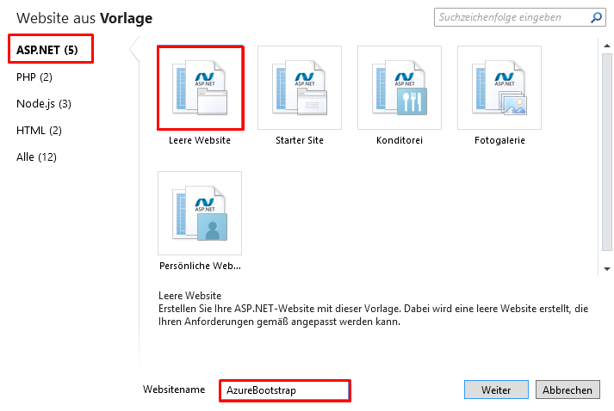
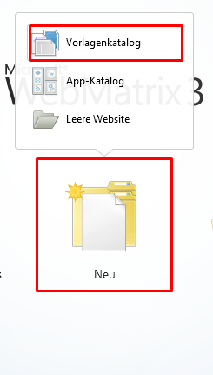
Create new Website
Create a blank ASP.NET website

Slide 5
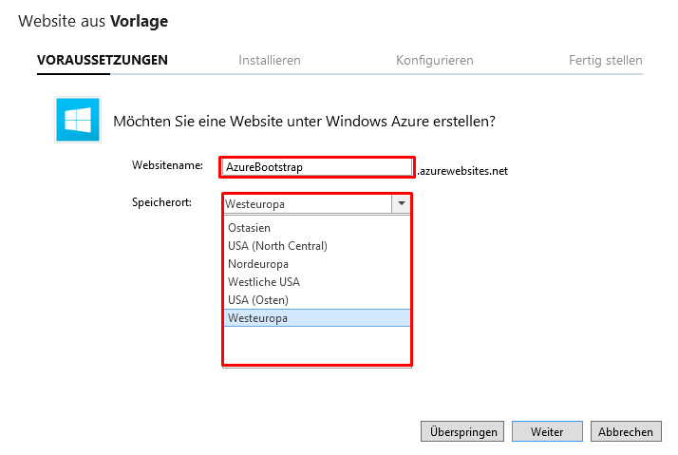
Connect with Windows Azure
Define webadress
Set server location for website storage

Slide 6
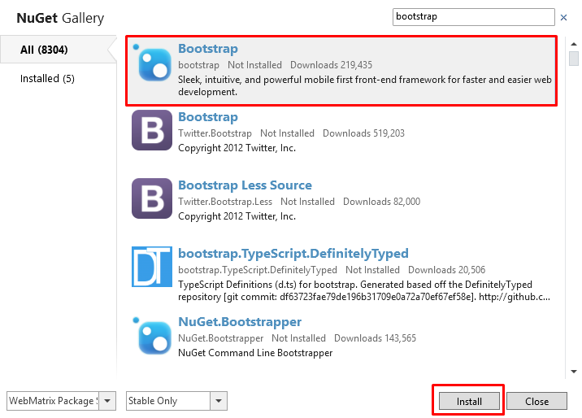
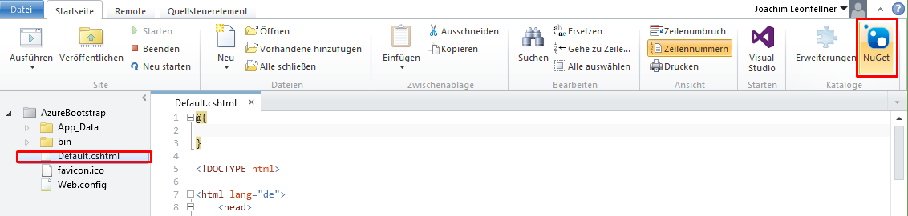
Use NuGet to install Bootstrap
NuGet package manager for .NET
Install Bootstrap
Check for latest version

Slide 7
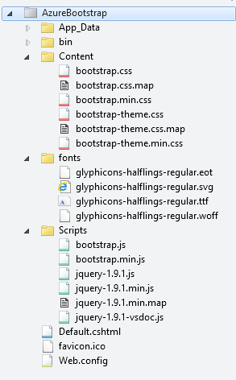
Success
NuGet adds Bootstrap to project

Slide 8
Demo

Slide 9
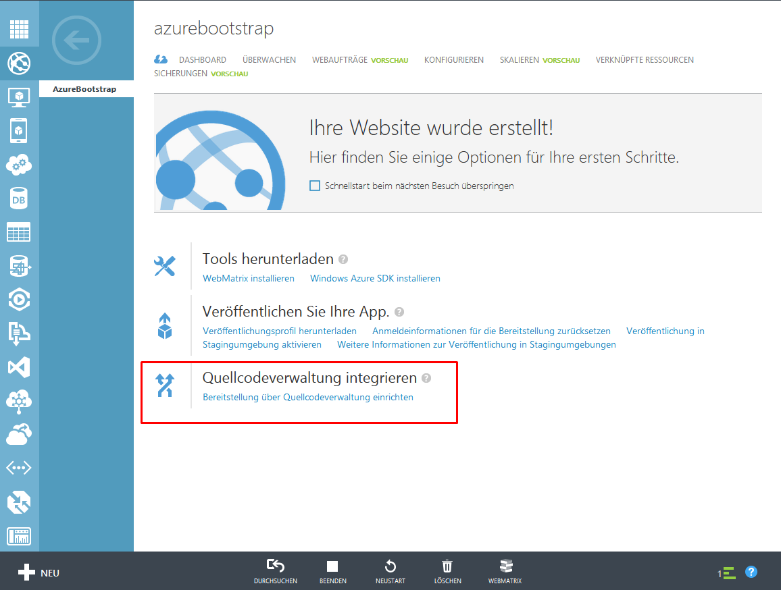
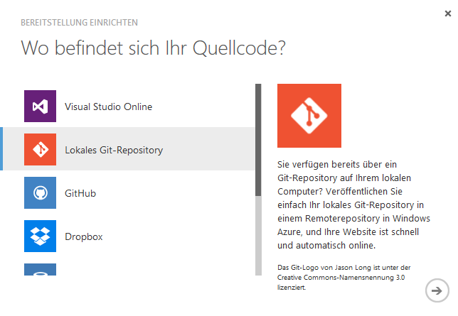
Enable Git Version Control
Add source management
Select local Git repository

Slide 10
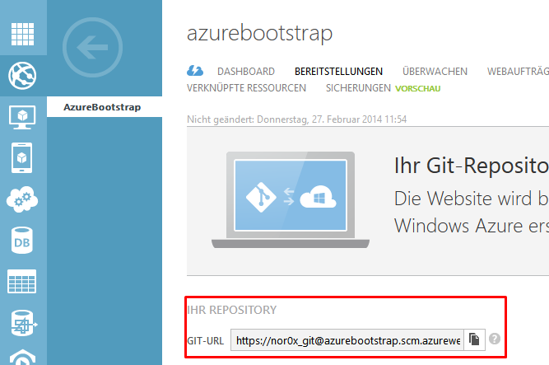
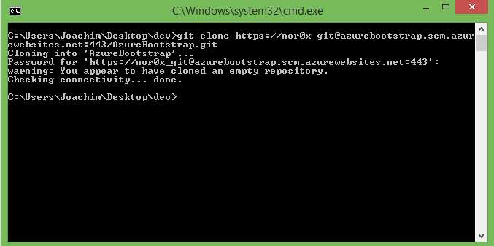
Clone Project

Slide 11
Deploying with “git push“
Add Windows Azure as Git remote
git remote add azure [url]
Commit changes
git commit –m “message“
Deploy commits to Windows Azure
git push azure master

Slide 12
Demo

Slide 13
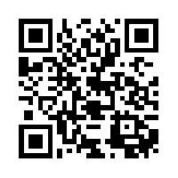

Resources
http://aka.ms/jquery2014
© 2013 Microsoft Corporation. All rights reserved. Microsoft, Windows, Windows Vista and other product names are or may be registered trademarks and/or trademarks in the U.S. and/or other countries.
The information herein is for informational purposes only and represents the current view of Microsoft Corporation as of the date of this presentation. Because Microsoft must respond to changing market conditions, it should not be interpreted to be a commitment on the part of Microsoft, and Microsoft cannot guarantee the accuracy of any information provided after the date of this presentation. MICROSOFT MAKES NO WARRANTIES, EXPRESS, IMPLIED OR STATUTORY, AS TO THE INFORMATION IN THIS PRESENTATION.

